Slide 1
moodfood
by 4 foodies
Chelsey Dolan, Anna Ly, Justin McLaren, Simeon Utubor

Slide 2
M O O D F O O D
Helps answer the age-old question: “What should I eat?”
Brings you food options nearest you based on your mood
Type in your current mood, and you will be provided with a food option closest to your zip code
Don’t like the choice we gave you? That’s okay – we’ll give you five more choices.

Slide 3
D E V E L O P M E N T
Front-End
Anna and Justin
Process included:
Wireframing
Mockup
Back-End
Chelsey and Simeon
Process included:
Google Places API
IBM Watson API

Slide 4
B E H I N D T H E S C E N E S
Simple, sleek, and user-friendly app development
Inspired by personal challenges on choosing what to eat
Too many choices can be overwhelming
App provides one option at a time with a max of five choices

Slide 5
P A R A M E T E R S
Distance (max: 10 mile radius)
Ratings (3.5 stars or greater)
Open now
Prominence

Slide 6
T E C H N O L O G Y
Front-End
HTML
CSS
Bootstrap
Back-End
JavaScript
jQuery
Google Places API
IBM Watson Technology:
Sentiment and Emotion Tracker using Natural Language Understanding

Slide 7
D E M O
Check it out:
https://chelseymarie6.github.io/moodfood/

Slide 8
F U T U R E D E V E L O P M E N T
IBM Watson
Voice-input
Currently, we are asking a text input from the user for their mood. With future development, our application has the potential to interpolate a user’s emotion based on voice-input and then provide a food suggestion.
Additional factors beyond the parameters we selected (categorical style food selection, ratings, and location) could include:
User login/profile to keep track of their moods and food choices to ensure dynamic recommendations are being made
Integration with other apps such as a user’s calendar to plan ahead for meals
Could incorporate recipes, and/or grocery services beyond providing restaurant choices

Slide 9
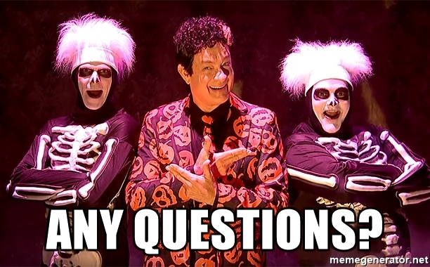
Q U E S T I O N S ?

